Slide 1


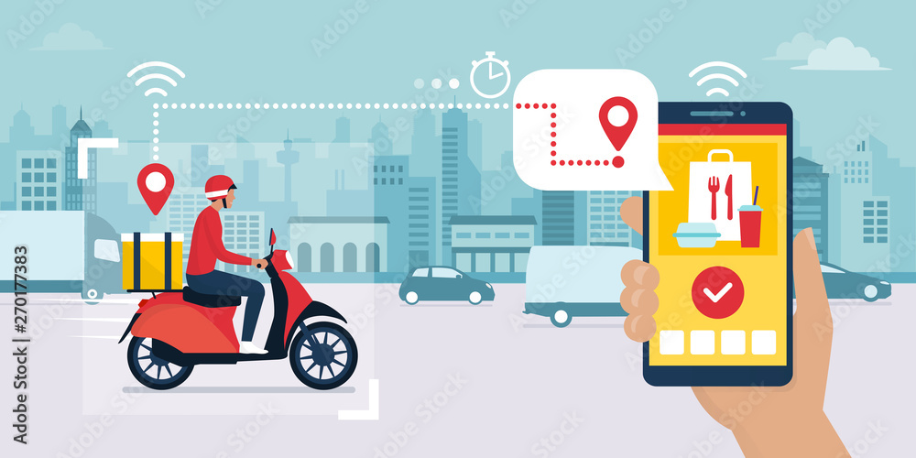
“Online Food Delivery Application”
Submitted by: M. Manisha
Submission type : Individual
Name: Online Food Delivery application.
Batch : 12
LMS Id :
Program :JAVA FULL STACK
Date: 26/06/2013

Slide 2

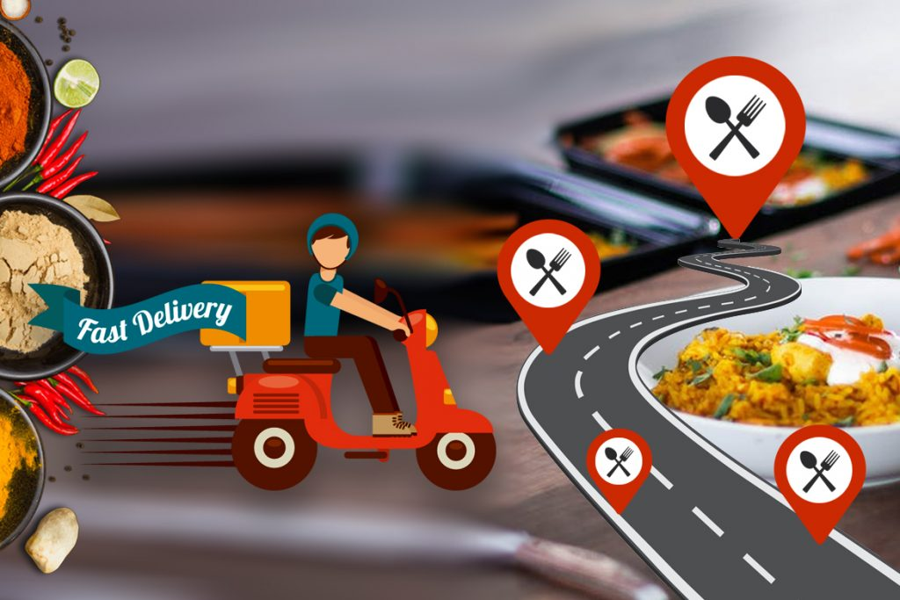
Table of contents
Introduction
Project Overview
Architecture Design
User Interface Design
Back-end Development
Front-end Development
Conclusion
Future Work
References

Slide 3
Introduction
The main objective of the Online food delivery is to manage the details of Food items, Category, Restaurant, Cart Order, Customer. An online food ordering system is software that lets restaurants, accept orders online. It typically allows customers to choose and pay for food. This happens without contact between staff and customers. Customers can easily place orders as they like using the online meal ordering system, which sets up a food menu online.
Online food ordering gives customers the freedom and choice to place an order at virtually any time, from anywhere, saving the time and resources typically spent on travelling to pick up a meal. It also gives the customers the advantage of reordering the favorite order in the easiest and hassle-free manner
Life in a digital world has made people accustomed to the convenience of getting whatever they want or need with just a few clicks of a button. Customers now expect their favorite restaurant to offer online ordering.
COVID-19 has contributed to huge growth in the demand for online ordering.

Slide 4
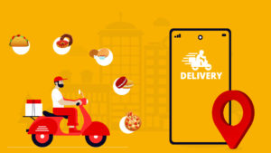
Project Overview
The main functionality of the Online food delivery is to manage the details of Food items, Selection of restaurant, Category, Cart Order, Customer. It manages all the food item , Delivery, Customer, Food item.
An online ordering system is software that lets your restaurant accept and manage orders placed online. An online food ordering system generally has two components – a website or app that allows customers to view the menu and place an order, and an admin interface that enables the restaurant to receive and ful-fil customer orders.
We have implemented the project by using technologies like Java, Spring-boot, Database (My-Sql),React Js.
Advantages of online food delivery for customers:
Choice of multiple cuisines
Safer than dining in
Vital marketing initiatives and mouth-watering food pictures that attract people
Get a different taste at home (as people are not feeling safe going outside)
Saves time.

Slide 5


Project Overview (1)
Project Overview(1)
Data Flow
Front end
Back end
Browser
Controller
Service
Repository
Entity
Database (MySQL)
(ReactJS)
Springboot Application

Slide 6


Project Overview (2)
Technologies Used:
1. Front End Used :
React JS(Visual studio code )
2. Back-end Used :
Spring Boot Java (Eclipse IDE)
Dependencies : Spring devtools, Spring security, Spring JPA, MYSQL Driver, Lombok, Spring Web
3. Database Used : MYSQL (SQL Yog)
4. Postman : For checking the API’s
Functions:
1) Crud Operations
2) Modules- Admin model, User model
5.Node JS: It is used to provide the npm tool, which is used to manage dependencies and install and manage libraries, modules and other resources required by your project.

Slide 7
Project Overview (3)
FUNCTIONALITIES IMPLEMENTED:
1. User Registration : If customer is new then he will register with all the necessary details.
2. Login /Logout feature : After Registration he will login through registered email and password.
3. Explore Menu : Customer will search for required menu items in menu list.
4. Add to Cart : Customer will add the items to cart through add to cart option.
5. View cart : Here customer can view the items which were added to the cart. He can also add the items and delete the necessary items needed.
6. Checkout /Payment/Delivery : Here customer will pay the bill through given options, he will mention the address details and place the order.
7. Admin features/Login : Admin can login through email and password.
8. Restaurant : Admin can perform the below operations, restaurant list is visible here.
9. Add restaurant : Admin can add the required restaurant.
10. Update restaurant : Admin can update the required restaurant through ID.
11. Delete restaurant : Admin can delete the required restaurant.

Slide 8
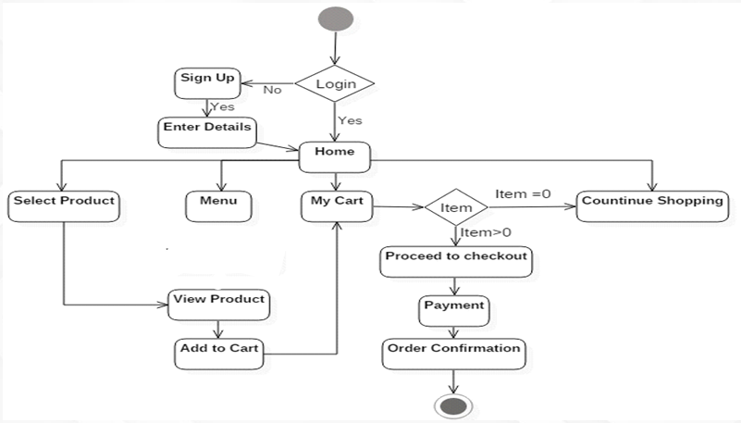
Architecture Design

Slide 9
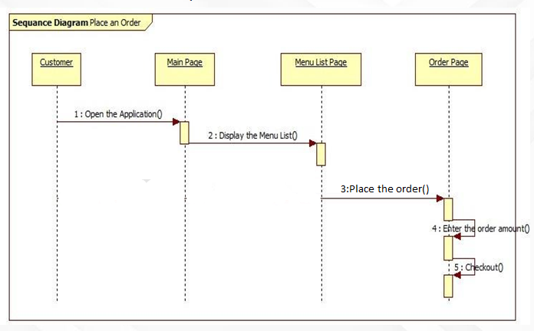



User Interface Design
SEQUENCE DIAGRAM

Slide 10
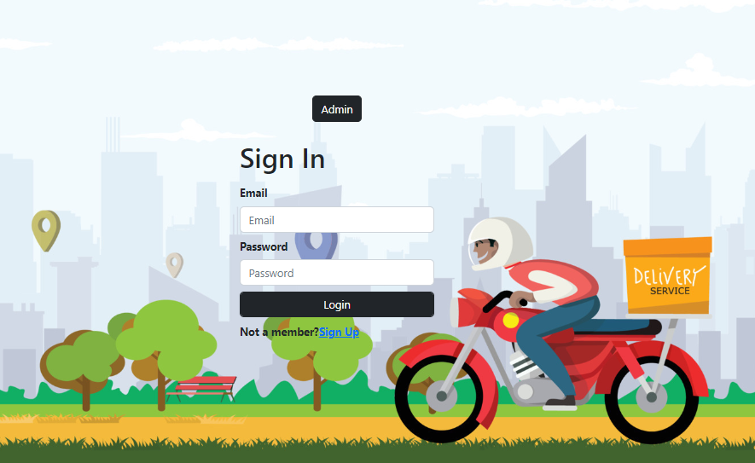
User Interface Design

Slide 11
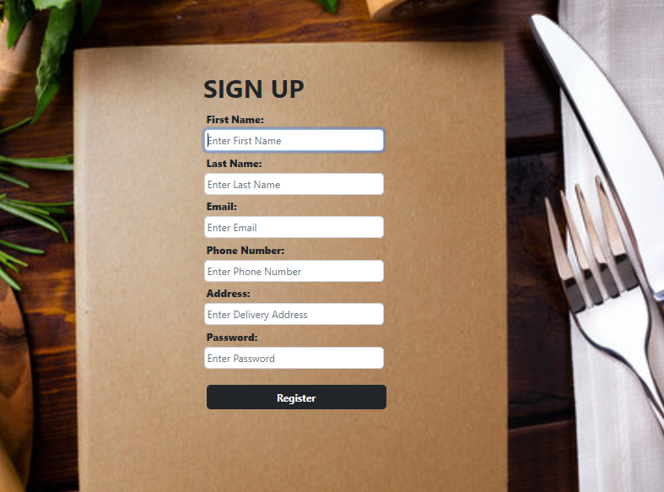
User Interface Design

Slide 12
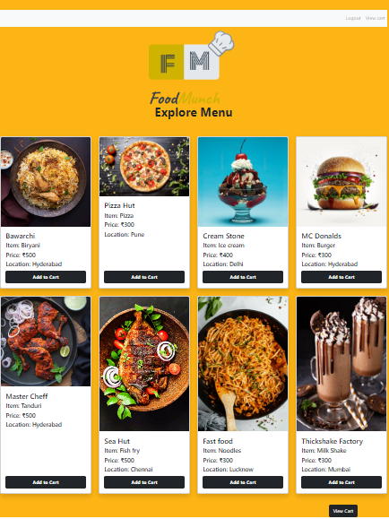
User Interface Design

Slide 13
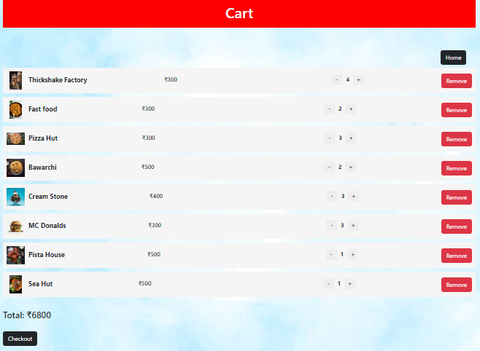
User Interface Design

Slide 14
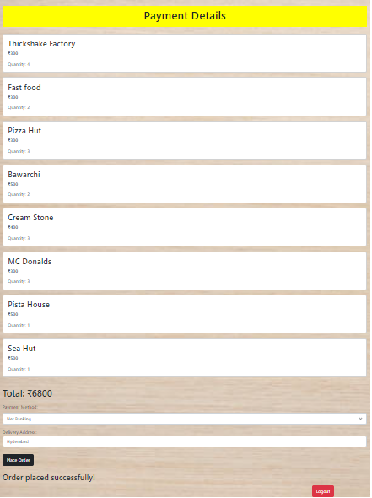
User Interface Design

Slide 15
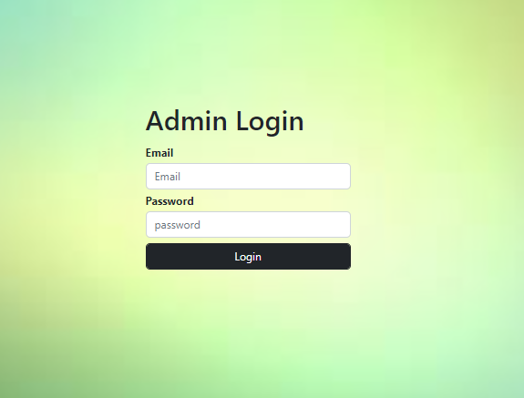
User Interface Design

Slide 16
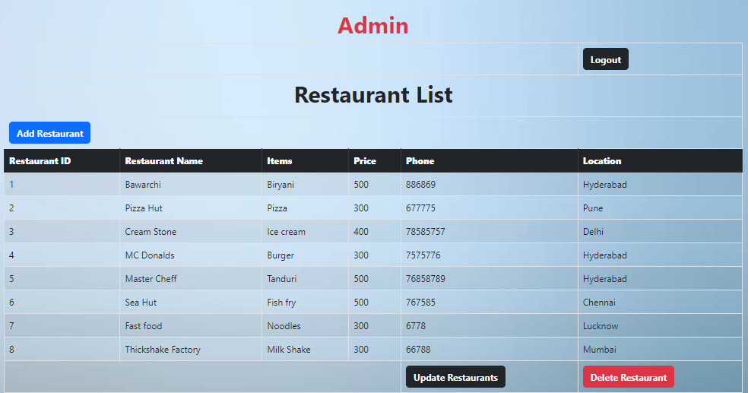
User Interface Design

Slide 17
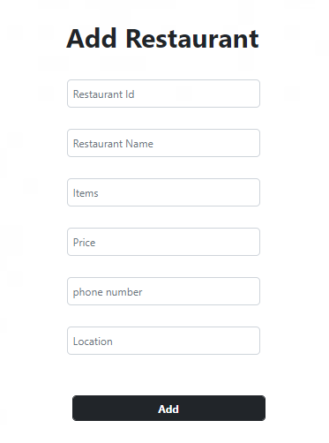
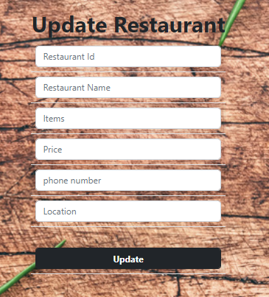
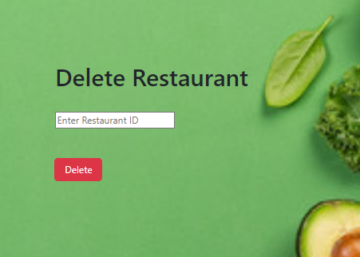
User Interface Design

Slide 18
Back-end Development
Implemented the Back end using following functionalities:
1. Spring MVC for the presentation layer, interaction with the front end.
2. Lombok is used to reduce the boilerplate code and enhance code readability.
3. Spring JPA is used along with Hibernate for efficient database access through the repository layer.
4. MySQL Driver is used to connect the database through Eclipse.
5. Spring security is implemented to secure the registration and authentication process.
6.Postman is used to test or verify the functioning of Rest API’s.

Slide 19
Front-end Development
REACT JS : A java script library for building user interfaces, often used for creating dynamic and interactive web applications.
HTML
CSS
Boot Strap
Java-Script
Implemented the properties of web pages was done using react properties.

Slide 20

Conclusion
The Online Food Delivery Application was developed using Spring Boot as Back-end and React for Front-end.
Thus, the implementation of Online Food Ordering system is done to help and solve one of the important problems of people. Based on the result of this research, it can be concluded:
It helps customer to make order easily
It gives information needed in making order to customer.
The Food website application is made for mess can help them receiving orders and modifying its data and also it is made for admin so that it helps admin in controlling all the Food System.

Slide 21

Future Work
The future work that can be done to improve the application, by adding more required functionalities like.
Delivery Timing
Additional features in user and admin.
Feedback and rating
To advance the existing features.
To deploy project

Slide 22
References
Spring Boot Official Documentation:
https://docs.spring.io/spring-boot/docs/current/reference/htmlsingle/
2. React.JS Official Documentation:
https://legacy.reactjs.org/docs/getting-started.html
3.Oracle Java Tutorial:
https://docs.oracle.com/en/java

Slide 23


